Slide 1
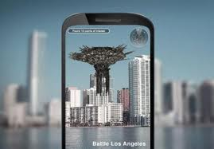
Augmented Reality and Project Glass
Nosipho Masilela
COSC 480

Slide 2
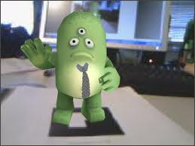
Augmented Reality
Define Augmented Reality
Augmented Reality vs. Reality
History of AR and its Applications
Augmented Tracking
Future of AR
Google’s Project Glass
Conclusion

Slide 3
Augmented Reality
Augmented Reality
Def: An artificial environment created through the combination of real-world and computer generated data.
Augmented Reality was initially designed for medicine, military and maintenance purposes.
So companies interested in mobile development such as Nokia, Qualcomm, Google are willing to fund research on AR.

Slide 4
Virtual Reality vs. Augmented Reality
Virtual Reality (VR)
a computer generated, interactive, 3D environment in which a person is immersed : virtual, interactive and immersive
Augmented Reality (AR)
Supplements the real world with the virtual(computer generated) objects that appear to coexist in the same space as the real world.

Slide 5
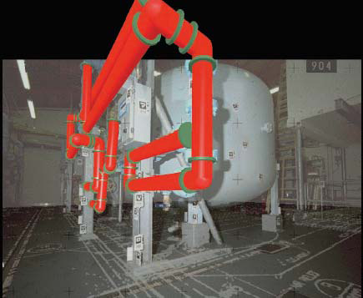
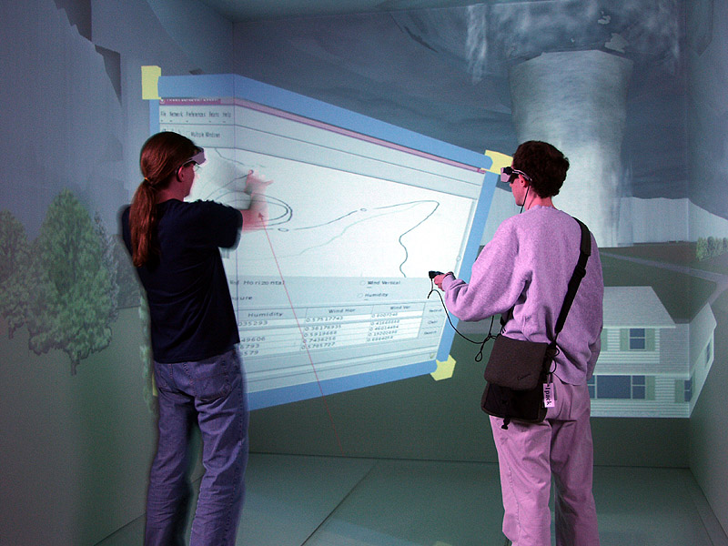
Augmented Reality vs. Virtual Reality
Engineering
Education –Virtual Storm

Slide 6
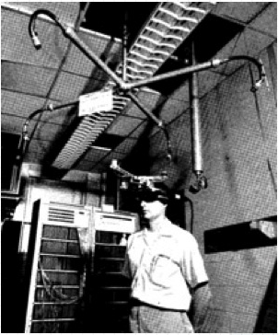
History of AR
Head Mounted Display (HMD)
1968 – Ivan Sutherland
Idea behind 3D display
Perspective image which changes as the user moves (kinetic depth effect)
Change experience must be the same as the image of a real object.
Must appear 3D without stereo dimension.

Slide 7
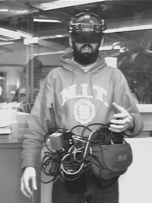
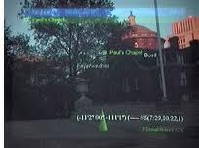
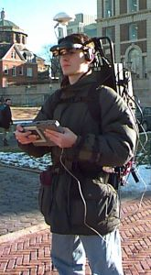
History of AR cont..
Global Pointing System
1993 – Military
Wearable Wireless Webcam
1994 – Steve Mann
Touring Machine
1997 – Steve Feiner
(Columbia University ,
New York.)
Battlefield Augmented
Reality System (BARS) – 2000
Notes:
A GPS receiver calculates its position by carefully timing the signals sent by the constellation of GPS satellites.
S Mann wore his webcam for two years streaming his vision to his website.
Touring Machine : It is a prototype system that combines together the overlaid 3D graphics of augmented reality and the freedom of mobile computing. It idea was to introduce an application that would render more information about a university’s campus, using a head tracked , see-through head-worn 3D display and an untracked, opaque, handheld 2D display with stylus and track pad.
BARS – The system targets the augmentation of a battlefield scene with additional information about the environment infrastructure, but also about the possible enemy ambushes.

Slide 8
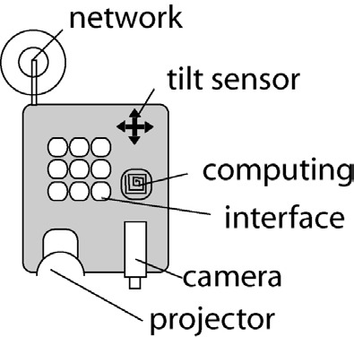
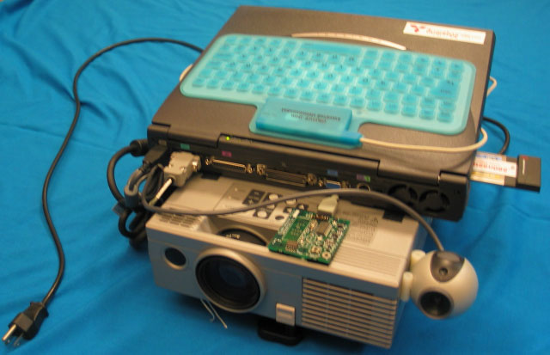
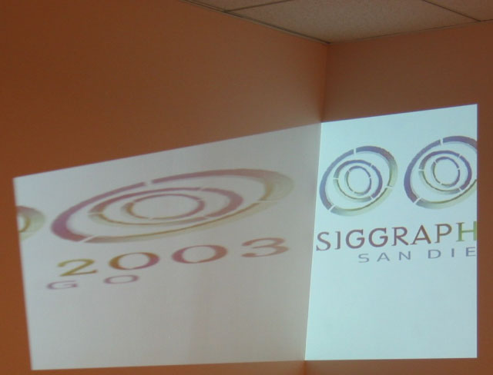
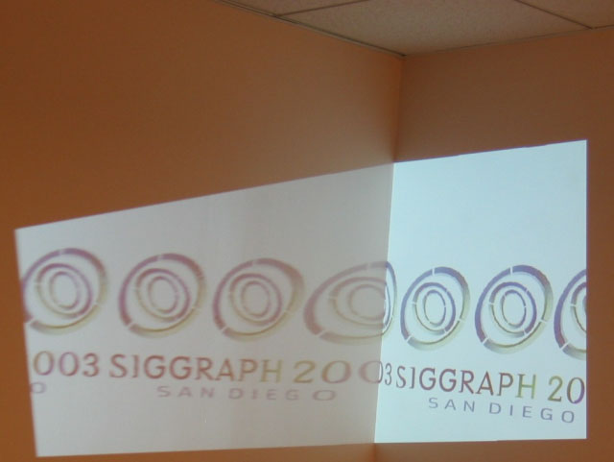
History Cont..
History of AR cont..
iLamps(2005) ~ An enhanced projector that can determine and respond to the geometry of the display surface to create a self-configuring display.
Shape adaptive display
Object-adaptive display
Projecting content onto a recognized object.

Slide 9
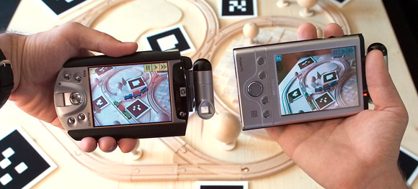
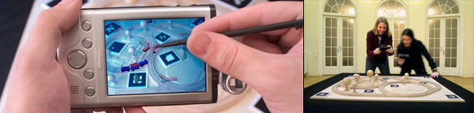
History of AR Cont…
The Invisible Train (2004)
A multi-user AR application for handheld devices.
Players control virtual trains on a real wooden miniature railroad track.
Magic lens metaphor.
Players can interact with the game environment by operating track switches and adjusting the speed of their virtual trains.
common goal of the game is to prevent the virtual trains from colliding.

Slide 10
Augmented Tracking
“Tracking is the name given to an AR application’s attempts to recognize and follow the physical objects of a scene”(Georg Klein).
Three kinds of tracking for Augmented Reality
Marker-based
Known texture or pattern recognition
Parallel Tracking and Mapping (PTAM)
Notes:
There’s marker-based tracking which is what the likes of the ARToolKit looks for through you computer webcam. It asks for that specific shape to be recognized. It’s limited but idiot proof.
Next is known texture or pattern recognition where the software might look for a magazine page, CD cover, Lego box, something known. It’s trained to recognise that thing very quickly. It’s used commercially but it must work on geometry that’s known in advance.
Augmented Reality Tracking system. A computer tracks a camera and works out a map of the environment in realtime and can be used to overlay virtual graphics. is a piece of computer vision software which can track the 3D position of a moving camera in real time. It is a SLAM system that does not need any prior information about the world (like markers or known natural feature targets) but instead works out the structure of the world as it goes. PTAM is useful primarily for augmented reality, although it has been applied to other tasks (robot guidance) as well.

Slide 11
Future of AR: Google’s Project Glass
Blue-sky project by Google’s mysterious research and development arm, Google X.
Project Aim
To augment your everyday experiences by superimposing a layer of visual indicators directly onto your field of vision.
Natural language voice commands
Google’s Android Operating System
If your smartphone could be a visor
Notes:
It will connect you to ur friends, provide data about your surroundings and potentially replace ur smartphone

Slide 12
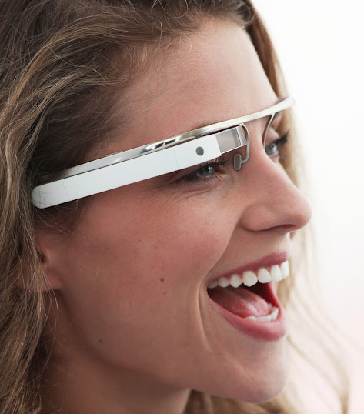
Future of AR: Project Glass
Project Glass Video

Slide 13
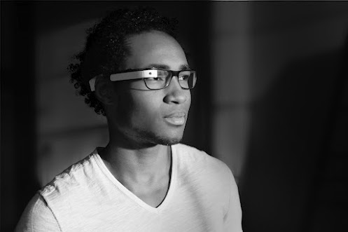

Future of AR: Project Glass
Provide 3G or 4G wireless connection
More of a concept than an actual product
Mounting the device onto prescription glasses
UI Problem
Interaction through a wristbands with haptic feedback

Slide 14
Conclusion
Augmented Reality – to overlay computer-presented material on top of the real world
History of AR ~ the Head Mounted Display (HMD)
Augmented Tracking
Future of AR
Google’s Project Glass

Slide 15
References
Daniel Wagner, Thomas Pintaric And Dieter Schmalstieg. The Invisible Train. A Multi-player Handheld Augmented Reality Game. 2005 http://studierstube.icg.tugraz.at/invisible_train/
Klein, George. Parallel Tracking and Mapping. http://www.robots.ox.ac.uk/~gk/youtube.html
Mann, S. Wearable Computing: A First Step Toward personal Imaging. IEEEXplore. Vol.30, Issue: 2 p.25- 32. February 1997.
Simon Julier Yohan , Simon Julier , Yohan Baillot , Marco Lanzagorta , Dennis Brown , Lawrence Rosenblum , “BARS: Battlefield Augmented Reality System”, NATO Information Systems Technology Panel Symposium on New Information Processing Techniques for Military Systems, 2000.
http://www.slideshare.net/iglassbox/history-of-augmented-reality-after-2000
Sutherland, Ivan. “A Head-Mounted Three Dimensional Display”. Proceedings of Fall Joint Computer Conference, 1968, pp. 757-764. ACM
GooglePlus. Project Glass https://plus.google.com/111626127367496192147/posts

Slide 16

Questions

